Slide 1
EESTI HOKI
Estonian Ice Hockey Association
Rainer Komi 16.03.2019

Slide 2
Eesti Hoki in numbers
 | 2016/2017 | 2017/2018 | 2018/2019
Ice halls in Estonia | 7 | 8 | 9
Ice rinks in Estonia | 10 | 11 | 14
Number of clubs | 29 | 30 | 34
Number of members of EIHA | 16 | 20 | 20
Male players | 107 | 92 | 105
Female players | 50+ | 76 | 94
Youth players | 556 | 655 | 841
Amateurs | >700 | >800 | >850
Qualified coaches | 32 | 35 | 37

Slide 3

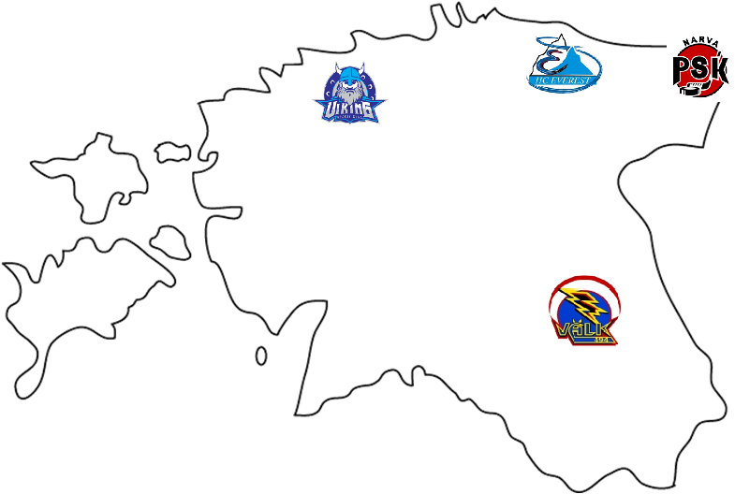

Slide 4

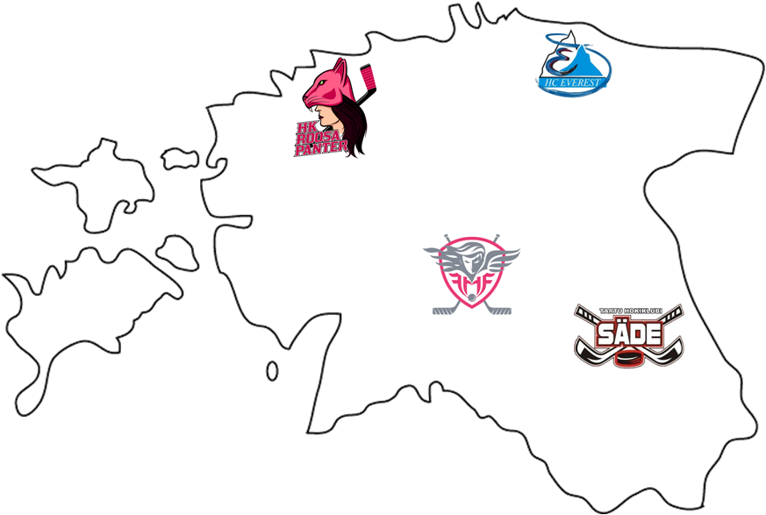

Slide 5
Ice Hockey compared to other team sports
 | PLAYERS | CLUBS | WORLD RANKING
ICE HOCKEY | 1551 | 34 | 26th
FOOTBALL | 21511 | 181 | 96th
BASKETBALL | 8649 | 148 | 45th
VOLLEYBALL | 6160 | 150 | 26th
FLOORBALL | 1446 | 37 | 9th
HANDBALL | 2260 | 18 | 74th

Slide 6
Eesti Hoki vision:
We believe that everyone has the chance to utilize their personal potential as a human being and as an athlete through ice hockey and therefore enjoy life in Estonia.
Eesti Hoki values
RESPECT
UNITY – One nation, one flag, one team
COMMITMENT – In everything we do
JOY & FUN – from doing things and playing together
Eesti Hoki mission:
We take action to grow our diversified hockey family and for Estonian hockey to last for years to come.

Slide 7
External stakeholders
Universities
Deans
Sport departments
Estonian Ice Hockey Association
Good output for junior players
  Late development
  Competitive level
Foreign players in Estonia
Sponsors & Partners
Local municipality
Parents
Educational value
Utilizing personal potential

Slide 8
Thank you !

