Slide 1



Swedish University Hockey League (UHL)
Stockholm 23/3 - 24/3

Slide 2



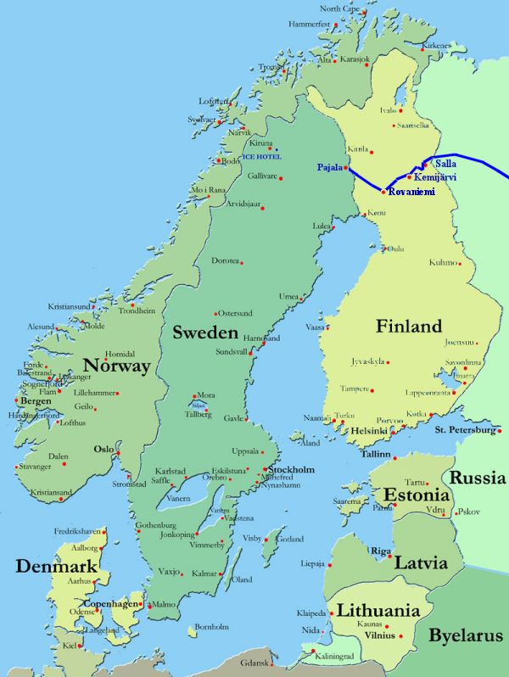





Overview of UHL

Slide 3
Structure
Non-profit
League President
Team representative Lund
Team representative Växjö
Team representative Chalmers
Team representative KTH
Team representative Jönköping

Slide 4
This season
All teams will play 6 games
Växjö had problems with players and the organisation they were not able to participate.
Due to bad communication between the team representatives and the league representative, very little progress with EUHL has been made.
The process of controlling the league is very time consuming and if too much work is handed out to the teams, it will be contra-productive.

Slide 5
Facts and figures
The longest away-game is between KTH and Lund, the traveling time is 5 hours just one way.
The cost for hosting one game is; 700 euro just in referee and ice rental.
KTH has won the League most times; 5 out of 7.
UHL is not considered an official league by the Swedish Hockey Association.
Most teams play in an additional league besides UHL
All teams are managed only by students

Slide 6
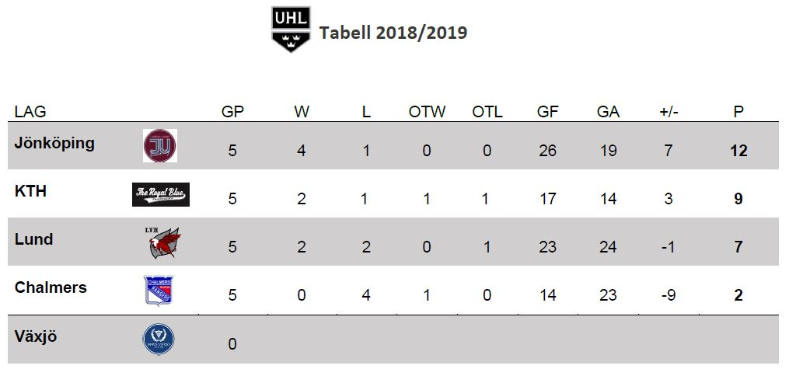
Standings of 2018/2019

Slide 7
Issues and opportunities
Issues
  Low interest to develop the league
  Teams and leagues economy
  The distance between teams
  The relationship with the Swedish Ice Hockey Association
  A person that has time to develop the league
  Teams relationship with local arenas
  The difference in organisational structure between teams in the league
Opportunities
  Find people that want to develop the league
  Find a league sponsor
  Create efficient and easy working processes
  Develop the relationship with EUHL
  Develop the relationship with SAIF

Slide 8
The future of UHL
9 teams
24 games for each team
Play-off and a final
A schedule that respect exam periods
President of the League
A board that is responsible of the league
Update content in real rime
Find a league sponsor
Create a better relationship with EUHL, SAIF and SIHF
Board of UHL
Team representative New team 1
Team representative New team 2
Team representative Lund
Team representative Växjö
Team representative Chalmers
Team representative KTH
Team representative Jönköping
Team representative New team 3
Team representative New team 4
New team
New team
New team
New team

Slide 9
Suggestion
EUHL North Division
The Swedish UHL will still exist and be part of the North Division
Games played between Swedish teams will be part of both the Swedish UHL and North Division
Statistics from Swedish and North Division games are uploaded to EUHL website and Eliteprospects
Sweden
Finland
Estonia
Latvia

