Slide 1

Starting a team in Växjö, Linnaeus university
interest group

Slide 2
Why Växjö ?
- Växjö as a sport city
- Linnaeus university and its campus
- Students and interest in icehockey

Slide 3
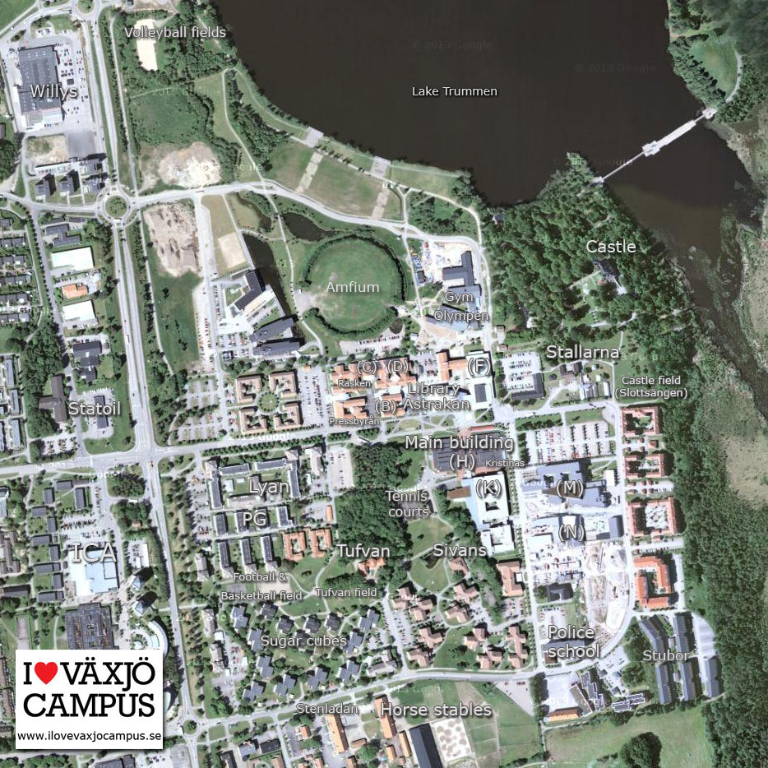
Campus as its own city
Events that takes place on campus
15 000 students, 6000 + lives on campus
Opportunitys

Slide 4
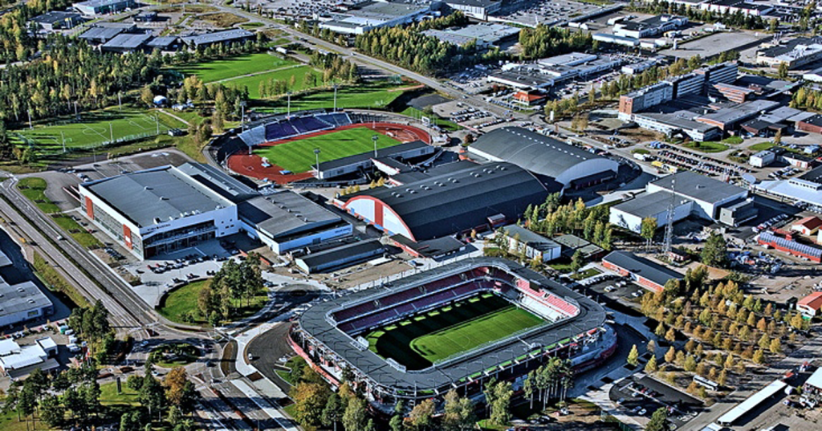
”Arena staden, Växjö”
-Sport center in Växjö
-The gathering of all sports and
Different clubs
-University sports has a place here!

Slide 5
Our goals with this project:
- Establish a fun and high skilled University hockey team and make a fun spectator events for students.
-Be the best University hockey team in Sweden.
-Establish our selfs in Europé as one of the best University teams to play in and watch.
Our vision with this project:
-Be the best university team on ice in terms of skill
- Be the best university team off ice in terms of spectator experience

