Slide 1

The obvious choice for student athletes

Slide 2
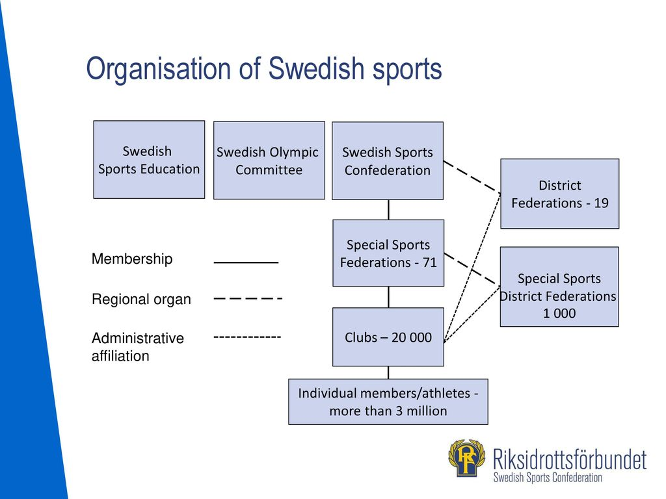


Slide 3
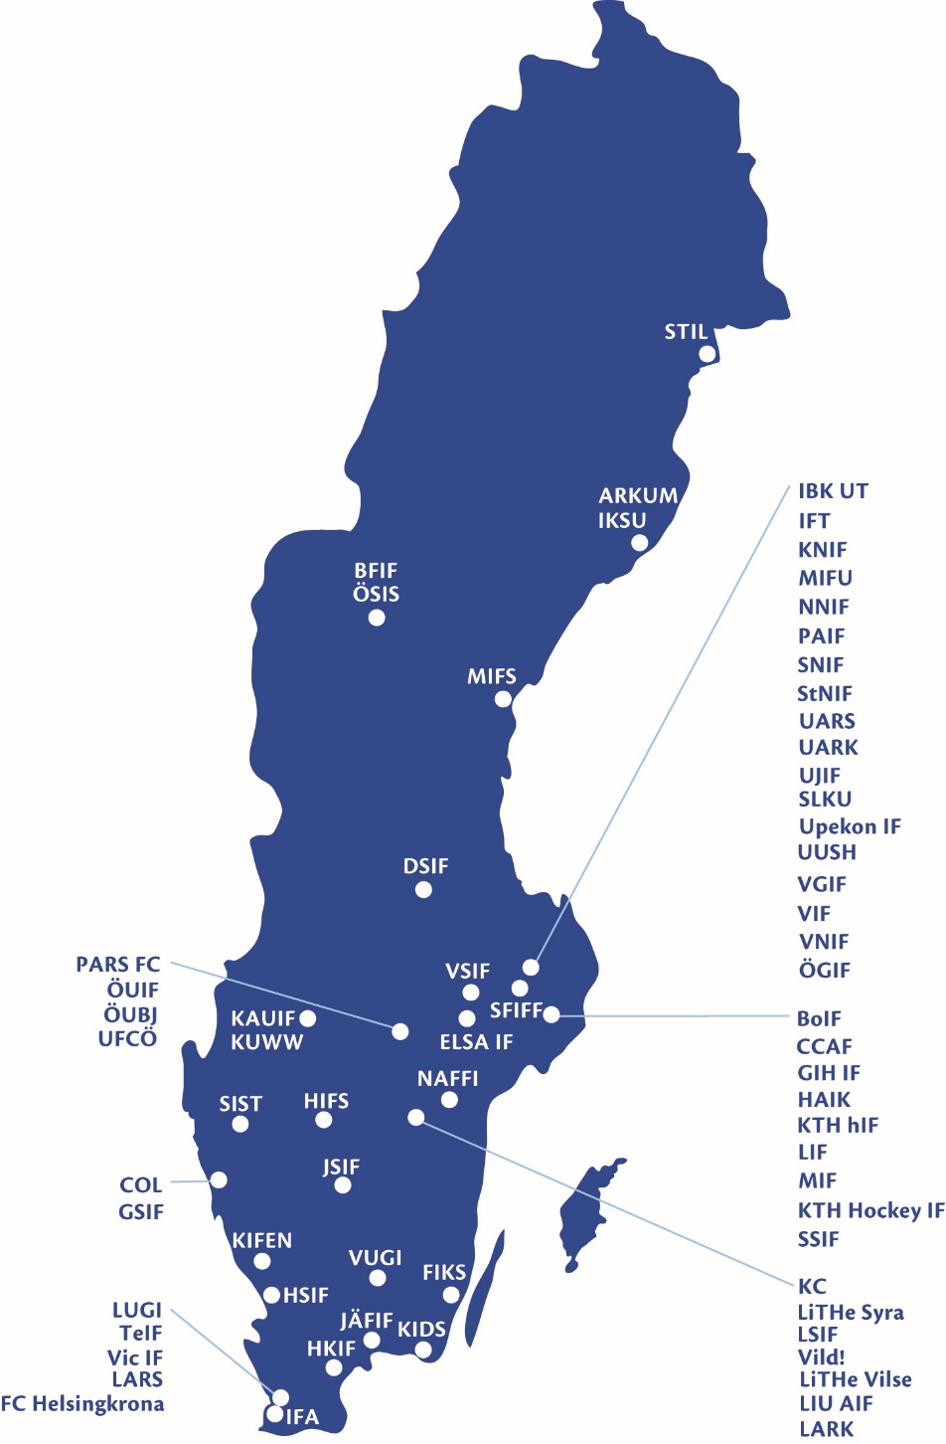

University sports all over Sweden
104 sport clubs
Over 52 000 members/athletes
The biggest sport club has 22 000 members and the smallest has 10 members
Around 50 different sports
football, ice hockey, equestrian, swimming, floorball, rowing, sailing, orienteering, gym and group training etc.

Slide 4
Strategy for university sports 2018-2020
Strong sport clubs
Viable and attractive sport clubs that works with development of their activities to attract new members
Students that are physically active
Show the correlation between physical activity and study result and have students find the happiness within physical activity in the Swedish university sports
Well-educated professional athletes
Swedish university sports is an active part in the support system around the universities of the Swedish sports federation and the elite athlete institutions to
achieve good conditions for dual careers

Slide 5


European University Sports Association
45 member associations
Cooperation with European associations and EU
Arrange around 20 European Championships every second year.
Participants at championships represent their University

Slide 6
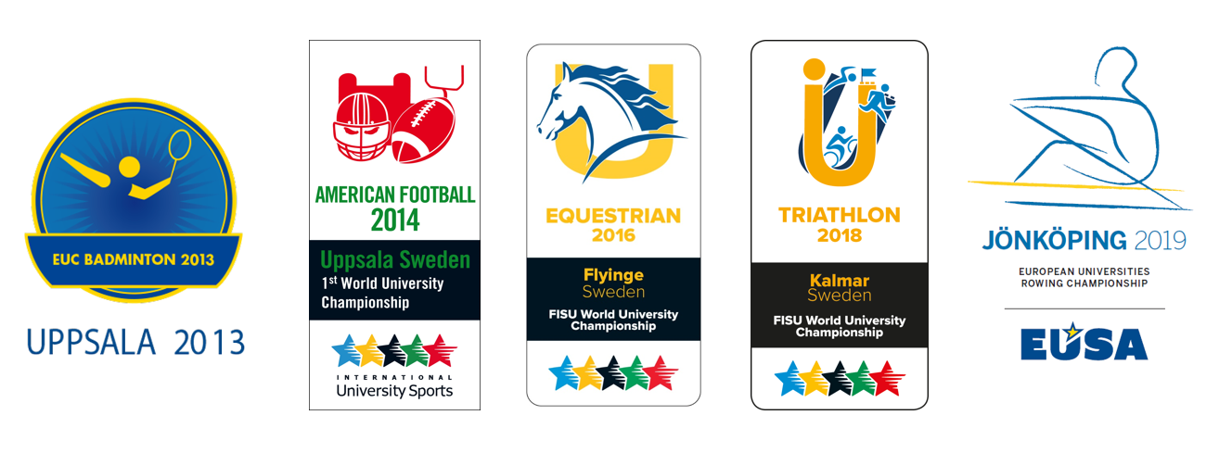
We love to organize International University Championships!

Slide 7
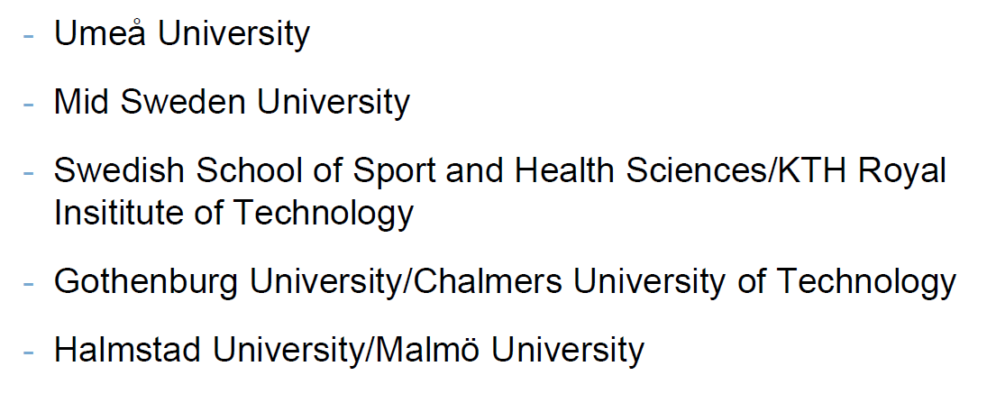

Dual careers
RIU/EVL- Universities

Slide 8
RIU/EVL-students
An RIU or EVL student is a potential or current member of a national team who is engaged in a high-performance sport at a level where flexible studies are necessary.
The core mission
is to facilitate dual carrers by ensuring that universities permit flexible studies and collaborate with national sports confederation in providing an elite sport environment.

Slide 9

Cecilia.vastgard@saif.se webb: studentidrott.se
Instagram: studentidrott
Thank you!

