Slide 1



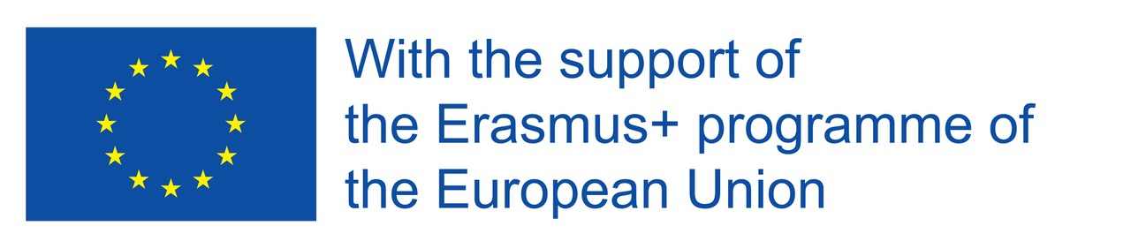
Kungliga Tekniska Högskolans Ishockeyförening (KTH Hockey)
Stockholm 23/3 - 24/3

Slide 2
History
The team was started in 2011 by initiativ taker and founder Joachim Rönnebäck Thomson with co-founder Pontus Håstlund.
2011/12 KTH Hockey played in the Swedish division 4
The first University game takes place 2012, KTH-Chalmers in Stockholm, final score 10-0 to KTH (!!!)
KTH advances to division 3 after winning the qualification in March 2013 where the team ha been playing since

Slide 3
Information about the team
Plays in UHL and Division 3 Östra, (fifth highest league in Swe)
The team consist of 30 players
Players from different fields of studies at KTH
This Universiade, KTH Hockey had 6 players that participated
Plays at Östermalms IP, just a few hundred meters from the school
KTH Hockey is the biggest sports association at KTH

Slide 4
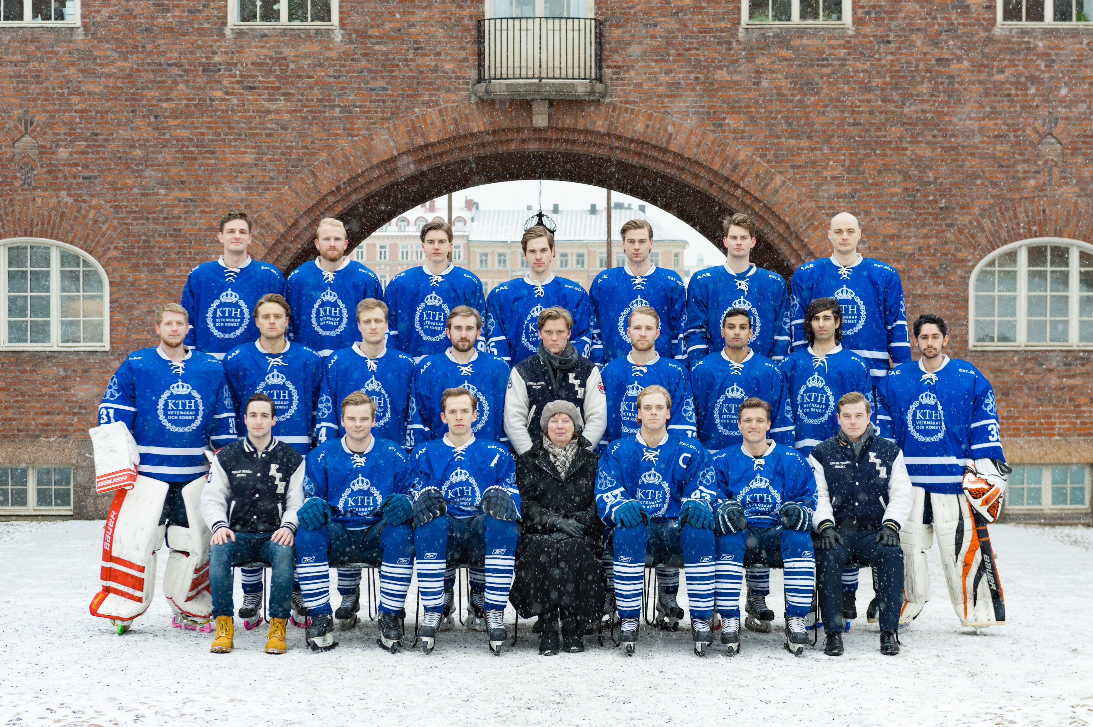

Slide 5
Structure of the organization
The board consists of 12 members
  Chairman of the board; David Östlin
  Vice Chairman; Magnus Orrsveden & Anton Haga Lööf
  Economy and budget responsible; Rasmus Eriksson
  UHL-responsible; Andreas Gunnahr
  Responsible for sports and coaching; Marcus Örtevall, Philip Singh
  Media responsible; Gustav Werneman
  Responsible for sponsors and funding; Nils Frisk
  Member of the board; Daoda, Celander, Wendt,

Slide 6
Relationships and Sponsors
Part of THS Sports
Good relationship with the University
Main sponsor Nasdaq
SAIF
Stockholm Hockey Association

Slide 7
Our Vision
The purpose of the association is to conduct ice hockey activities and there for compatible activities for students and employees at the Royal Institute of Technology. The purpose of the association is to represent KTH as a school in ice hockey in a proud and prestigious manner. The association will participate in games and other tournaments against top universities around Europe and North America

