Slide 1
How can stakeholders help professional athletes to achieve their life goals
Mart Habakuk
Estonian Business School
16 March 2019

Slide 2
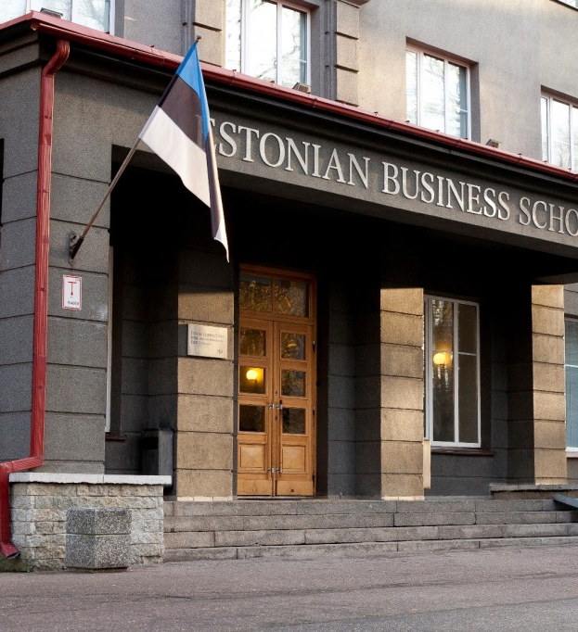
SA Estonian Business School
Private university established
in 1988
Campuses in Tallinn and Helsinki
1400 students from more than
30 countries. 300 from Finland
Alumni of 4900
60 partner universities

Slide 3
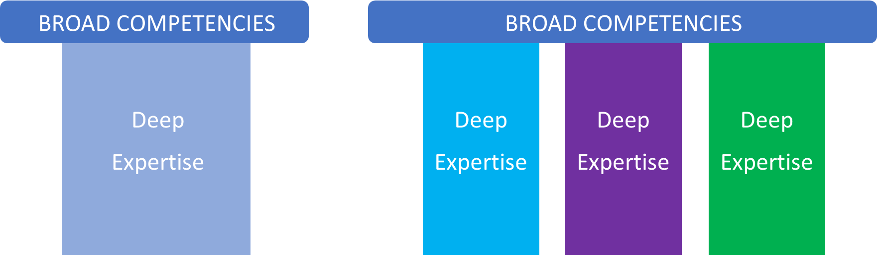
Future career
50 years of active life ahead
From career model T to career model M
Notes:
https://ourworldindata.org/life-expectancy
Life expectancy and intelligence
A recent study by Rosalind Arden et al (2015)9 analyzes the causes for the link between intelligence and longer lifespan. They note that many previous studies have found this correlation but that distinguishing the direction of the causality in this relationship is difficult. Common causes posited include socioeconomic status affecting both intelligence and life expectancy, higher intelligence causing more healthy behavior choices, and shared genetic factors influencing both intelligence and health. By analyzing three data sets of twins from the US, Sweden and Denmark, they determined that genetic factors contributed the most to the correlation between lifespan and intelligence.

Slide 4
Life Design
What do they really want?
Career is a process, not a destination
21st century skills
Foundational literacies (language, numeracy, science, IT, cultural literacy, ….)
Competencies (Critical Thinking, Creativity, Collaboration….)
Character Qualities (Curiosity, Initiative, Adaptability, Leadership, Emotional Intelligence ….)
Employee expectations 2022
Critical thinking
Active learning, collaboration, creativity
Complex problem solving

Slide 5
Professional athlete career development after high school
Life Design Course after high school
Meeting with stakeholders
Bachelor programme with emphasis on 21st century skills and competencies development
  Combination of on-line, blended and on-campus learning
  Summer school
  Erasmus exchange program

Slide 6

Professional athlete career development after Bachelors Studies
Return to Life Design Course after Bachelor Studies
Meeting with stakeholders
Part time Master Studies extended to up to 4 years
(20 hours per week study load)
Career, including life time learning
(10 hours per week up-skilling/re-skilling)

Slide 7
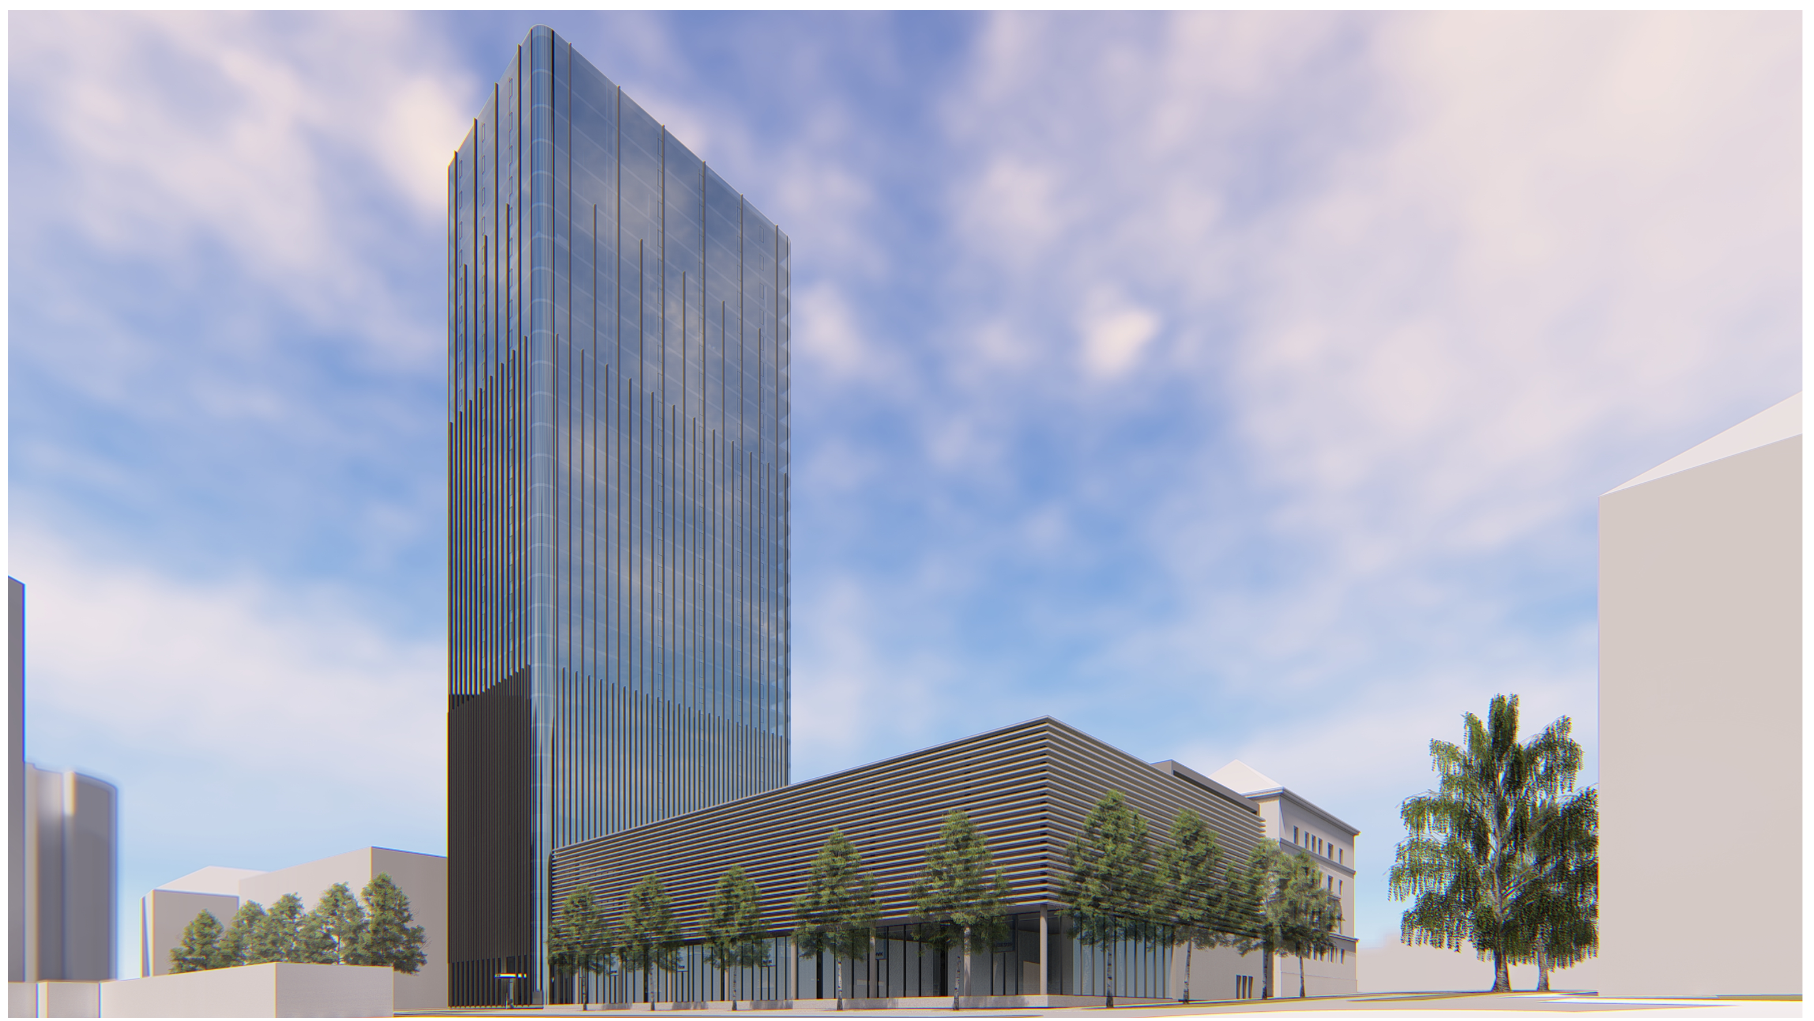

Slide 8
Mart Habakuk
Board Member of SA Estonian Business School mart.habakuk@ebs.ee

