Slide 1
Comparing the preparation of young ice hockey players in the Czech Republic and the USA
Václav Krudenc, Tomáš Brejcha

Slide 2
Timeline of the presentation
  Václav Krudenc: comparing junior hockey league in the Czech Republic and in the USA
  Tomáš Brejcha: comparing college hockey in the USA with European university hockey league

Slide 3
Introduction
Václav Krudenc, 23 y.o.
Faculty of law, Charles University – since 2016
Faculty of social sciences, Charles University – since 2017
Living in Prague
Member of Charles University hockey team

Slide 4
Hockey career
Started playing in SK Černošice
6 seasons for HC Sparta Praha
2015/2016 – Janesville Jets
  North American Hockey League
Since 2016 - EUHL

Slide 5
Czech U20 league
Very professional
On ice and off ice practice every day
Head coach, assistant coach, off ice coach, team manager
SCHOOL!! → practices in the evening
Preparing to become pro hockey player
No fans
Living home or at hotel
Some players get paid

Slide 6
North American Hockey League
Since 1975
Under USHL – tier 2
22 teams – 4 divisions
60 games + play off
More physical than czech league
Long distances – sleeping bus
Living in billet families
Preparing to get scholarship for college
  NCAA Amateurism rule – no money

Slide 7
Janesville Jets
On ice and off ice practice every day
Graduated players – no school
Head coach and assistant coach
Small town, the only sport team in the town
Big fan base
Community events

Slide 8
One day as a Jet
Wake up – 9:00
Off ice practice– 10:00-11:00
Lunch – 11:30
Meeting in the locker room – 12:00
  Video, warm up
On ice practice – 13:30-15:30
Sometimes team buildings/community events

Slide 9
Introduction
Tomáš Brejcha 29.6.1995
HC Sparta Praha
NAHL Lone Stars Brahams
NCAA D3 Curry College
EUHL Charles University

Slide 10

Curry College
Boston, MA
3 500 Students
Campus

Slide 11
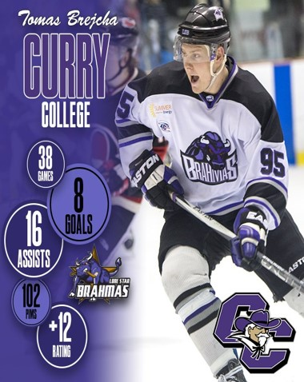
NCAA D3
Hard league
Strict rules
Professional approach
Commitment
Fun

Slide 12
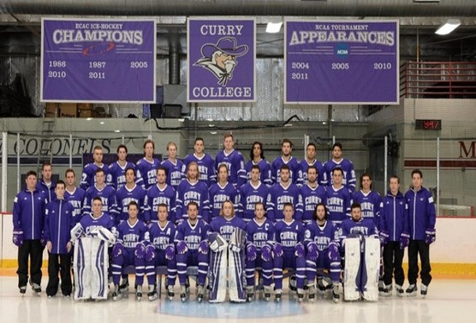
Facilities
Rink
Locker room
Gym
Trainer room
Traveling

Slide 13
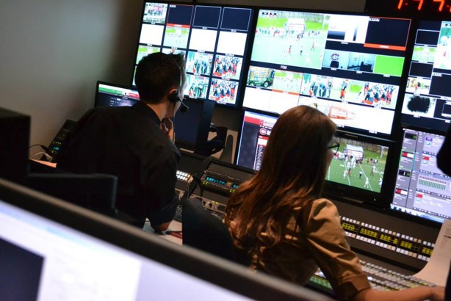
School media
Broadcast
Interviews
Students

Slide 14
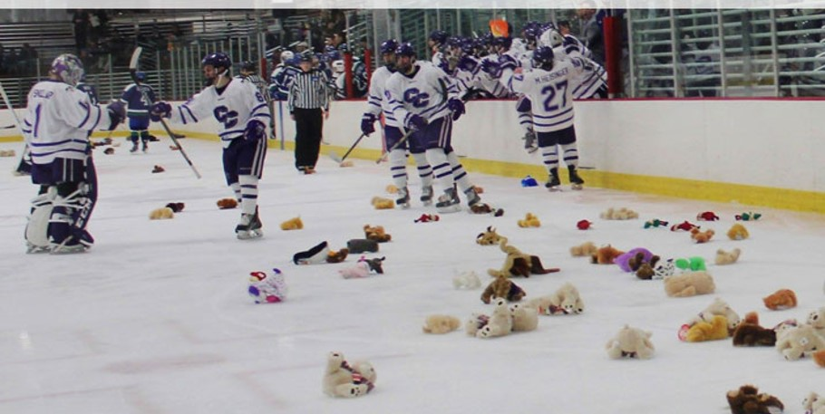
Teddy Bear Toos

Slide 15
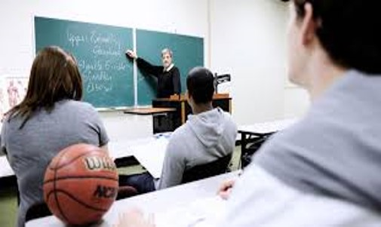
School
Grades
Study Hall

Slide 16
EUHL vs NCAA
Every day contact with your teammates
Practice
Grades are important
Rules in Team

