Slide 1



Conditional preparation in ice hockey and its possible specifications
Mgr. Štěpán Koukal
Brno 20. 9. 2018 – 22. 9. 2018

Slide 2
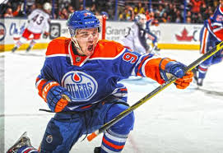
Key to succes
Endurance
Strenght
Speed
„Sprinters“ on blades
Less muscles, more power
Smaller players with low weight are more successfull

Slide 3

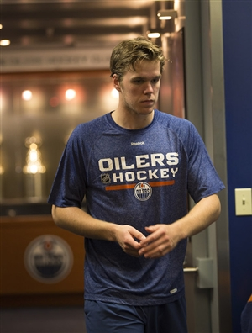

Slide 4
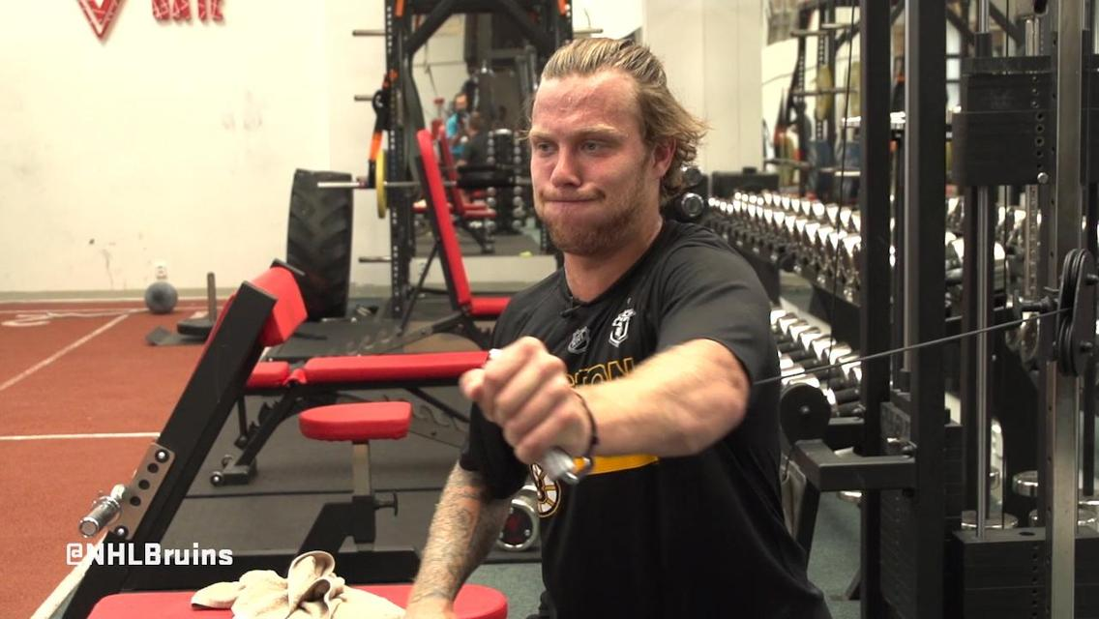
Individual off ice training
Pros
Aim on specific lack (strength, speed…), individual development
Performance technique
Cons
Costs
Team spirit

Slide 5
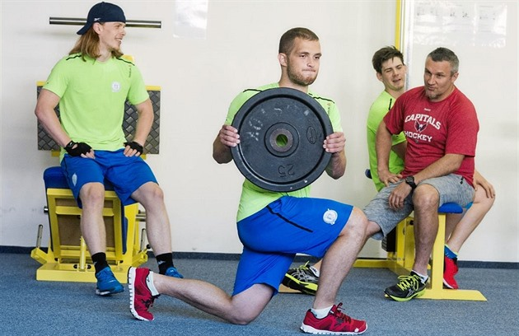
Team off ice training
Pros
Team spirit
Competitiveness
Cons
Methods of development that can not be done in 40 players

Slide 6
In the middle
Partition of players according to posts and performance
Small groups of players
More work for a trainer
Bigger player’s progress

Slide 7
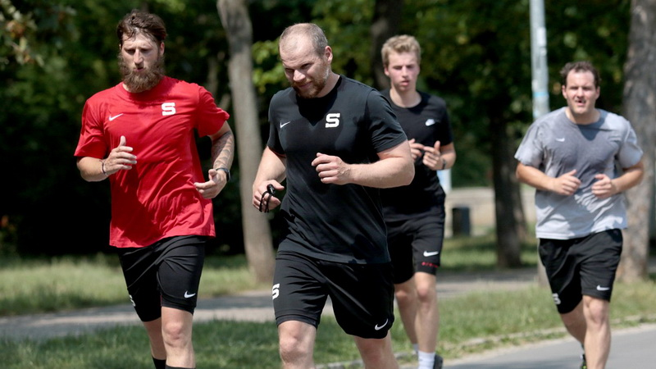
Off ice in czech republic
Starts on May 1st and ends June 30th
Then 3 weeks off
10-year old methods
Regular season starts in September

Slide 8
Off ice in North America and Canada
Starts in July
Ends in early September
Indvidual or small groups training
Individual periodization

Slide 9
Our off ice training system
Starts in July
Team training are 2 times per a week
Individual gym plan (updated after 2 weeks)
Off ice ends in early September
Individual training volume

Slide 10
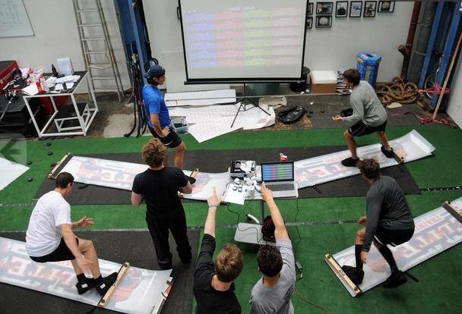
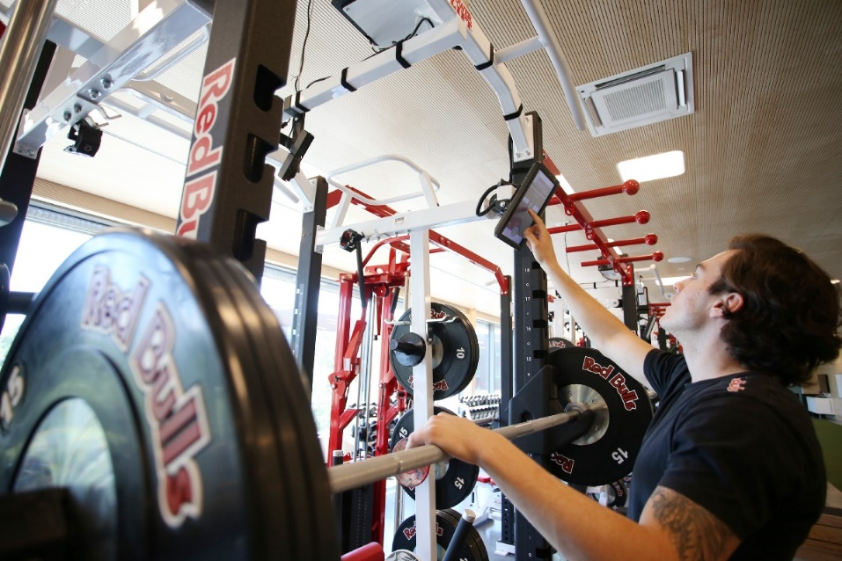
New trends in off ice training
Moxy monitor, spirotyger, wattbike…

Slide 11
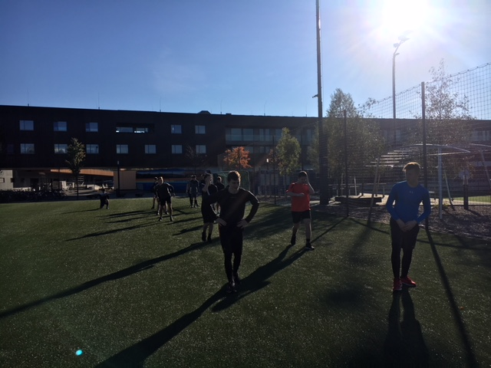
Dual Carrier tips
Practice for ice hockey coaches
Practice for SC coaches
Practice for physiotherapist
Career development

Slide 12
Sports internships – What is wrong?
Searching the Internet?
Offer from the University?
Offer from the Czech and Slovak Ice Hockey Association?
Results
Nothing

Slide 13
How to make an internship?
Exchange of experience across the EUHL
Knowledge development through EUHL
Short internships such as the Erasmus + project
Exchange of experience between universities

Slide 14
My internship experience
- Red Bull Salzburg Academy
I've been here for 5 days
Every day I have a new experience
It helped me a lot in my coaching career
Unfortunately, I had to arrange the internship myself
I paid for it myself

Slide 15
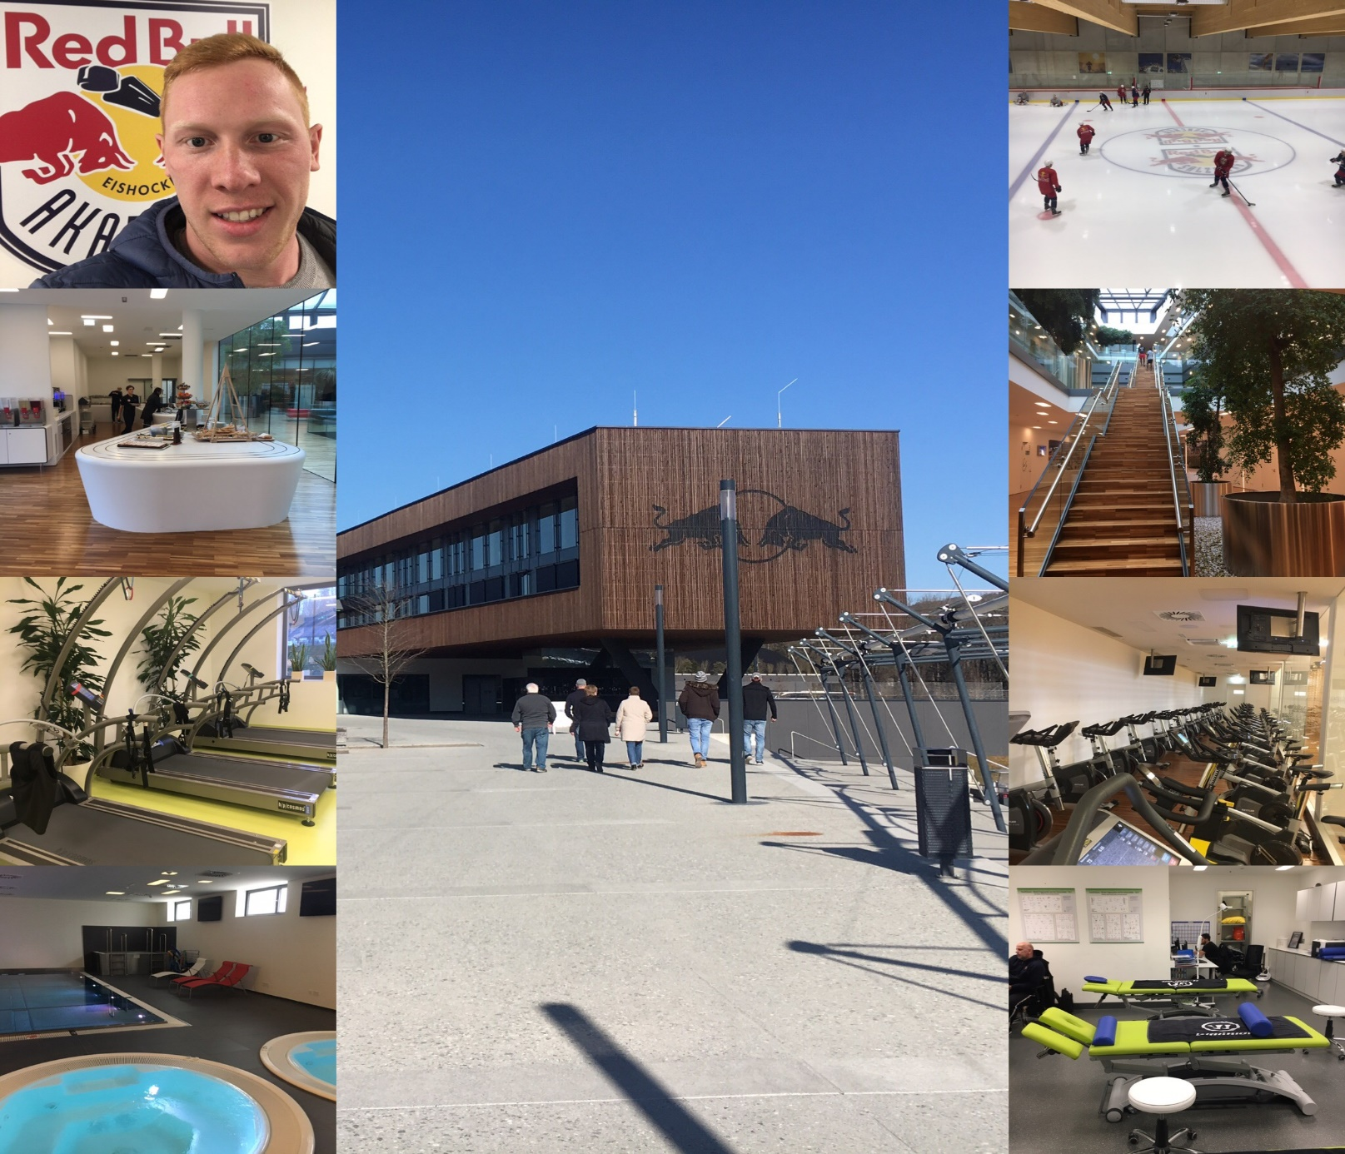

Slide 16



Thanks for your attention
Mgr. Štěpán Koukal
S & C coach Cavaliers Brno
Email: stepankoukal@email.cz
stepan_koukall
Facebook.com/ktstepankoukal

