Slide 1

University Hockey in the United States: from NCAA D1 to NCAA D3 to the ACHA
Bc. Patrick Rogan

Slide 2

A bit about myself
Played 3 years of Division I ACHA at Arizona State University
2009-10: finished #12 in country, made it to final 8 at national tournament
2010-11: finished #9 in country
2011-12: finished #4 in country
2015- the present: living in Prague and pursuing a Master’s Degree at Charles University

Slide 3

University Sports in America
Big business for universities → In 2016-17, ASU revenue from athletic department
(all sports) was more than 100 million US dollars for the first time ever.
Schools use athletics as a way to build prestige, but also as way to fund their academic departments.

Slide 4


University Athletic Conferences have their own television networks that will broadcast many different sports → Schools receive money for allowing these games to be broadcast
People just love college sports and in many parts of the country people are more interested in university sports than they are in professional sports.
For instance, Alabama football averages more than 100,000 fans per home game.

Slide 5

In total, there are more than 480,000 NCAA student-athletes each year.
Under no circumstances can student athletes receive money from their university
In recent years, there has been lots of controversy regarding schools exploiting athletes → rules prohibit athletes from getting paid, yet schools are making millions of dollars.

Slide 6

NCAA Division 1
60 teams
Best of the best → many graduates go on to play professionally: NHL, AHL, ECHL, top European leagues
According to the NCAA, “In 2018, 31% of players on active NHL rosters played college hockey (all Division I)”
      In 2000, this number was just 20%→ university hockey has become a more realistic way to launch a professional career

Slide 7
NCAA Division 1 Continued
Division 1 schools can offer scholarships.
In reality, not every player receives a full (or even partial scholarship)
Scholarships are renewed/changed every year → a player could start with a full scholarship, but after a poor season you might have to pay the next year.
Playing Division 1 hockey is like a full-time job. Strict training schedule of both on and off-ice training that has to be followed every day.

Slide 8
NCAA Division 3
84 teams, mostly on the East Coast and in the Midwest (traditional hockey states)
No scholarships offered. But hockey programs are completely funded by the university, so players don’t pay to play
Most D3 schools are smaller universities that can’t afford the enormous costs of running a D1 program.

Slide 9
NCAA Division 3 Continued
A few players each year will go on to play professional, but usually lower levels (ECHL, SPHL, lower leagues in Europe)
In general, players who decide to play Division 3 don’t expect to continue their career professionally after graduation

Slide 10

ACHA
Not affiliated with the NCAA
Was created in 1991, because the NCAA didn’t have
Enough teams
3 Divisions - Division 1: 59 team
- Division 2: 200+ teams
- Division 3: 150+ teams
  Very rare for players to continue to play professionally after graduating

Slide 11

ACHA Continued
Spread out across the country → teams in California, Nevada, Florida, Oklahoma, etc
Can provide different/unique university experiences to students who don’t want to attend university in a traditional hockey state.

Slide 12
ACHA Continued
No scholarships offered.
Hockey programs may be partially funded by the university.
In almost all cases, players will pay tuition for university + fee to play on the team.
This leads to huge differences between how teams are operated→ some teams are operated like an NCAA D1 or D3 program, while others are just glorified beer league.

Slide 13

Eligibility Requirements
NCAA (and ACHA) stresses the importance of being a student athlete.
Must be a full-time student → players have to be enrolled in 12 credit hours per semester (usually 4 classes) and must pass 9 credit hours.
At the end of each semester your grades are collected by the league → Grades in classes must meet minimum requirements to remain eligible.

Slide 14
Eligibility Continued
In NCAA Division 1, you usually sit out a year when transferring schools.
If played professionally before (Major Junior- WHL, OHL, etc.) then you are a ‘professional’ and can’t play.
In the NCAA there is drug testing, but not in ACHA→ failed drug test= year suspension.
4 Years of Eligibility + 1 red-shirt year if needed.

Slide 15
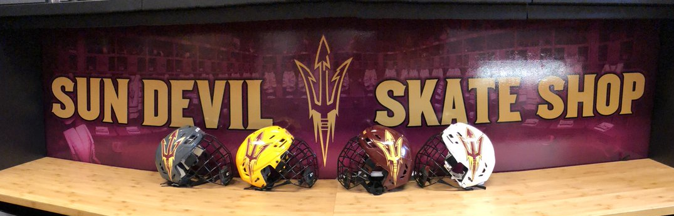
Ice Hockey at Arizona State University
2013-14: ASU won their first ACHA national championship
In November 2014, 32 million US dollars (approximately 700 million CZK) in private donations enabled ASU to transition to NCAA Division 1

Slide 16

The Transition
NCAA Arizona State
ACHA Arizona State
→ Average yearly operating cost 2.5 million US (approximately 54.5 million CZK), including scholarships, equipment, travel.
Received approximately 20,000 US (about 436,000 CZK) per year in funding from the university
Rest of the money came from players/fundraising/ticket sales.
Cost per player was between 2,000/3,000 a year, plus tuition

Slide 17
First NCAA D1 school west of Colorado (excluding Alaska) to have an ice hockey team.
Start of plan to expand NCAA to all of the country → so far no other teams have joined.

Slide 18
Every year there are more than 550 university hockey teams playing in the US.
Differences between the levels of competition can vary greatly→ the lowest level D1 teams and the highest level D3 teams are probably comparable → a high-level ACHA D1 team could play against an average NCAA D3 team.
But in general, NCAA Division 1 teams are by far the best.
EUHL= comparable to the top teams in the ACHA

